Slide 1

CV.io
Pitch Presentation

Slide 2

Table of contents
01
03
05
Introductions
Target Audience
Development Roadmap
02
04
06
Game Concept
Visuals & Art Style
Call to Action
Team Introduction
Game Introduction
Target Market
Current Progress and Timeline
Story & World
Gameplay Overview
Art & Aesthetics
Why Invest

Slide 3
01
Introductions

Slide 4



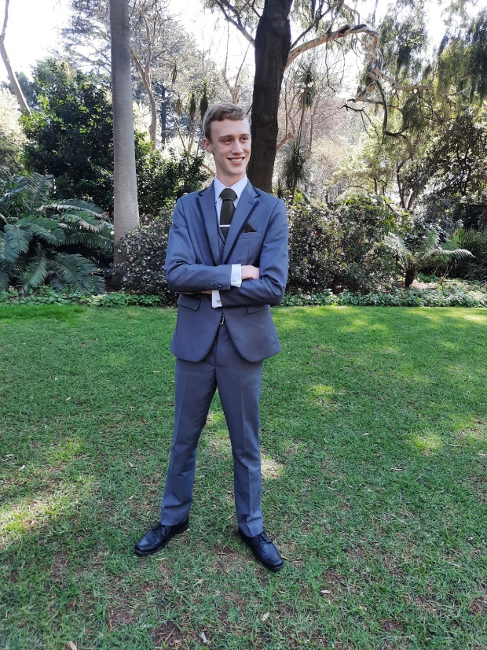

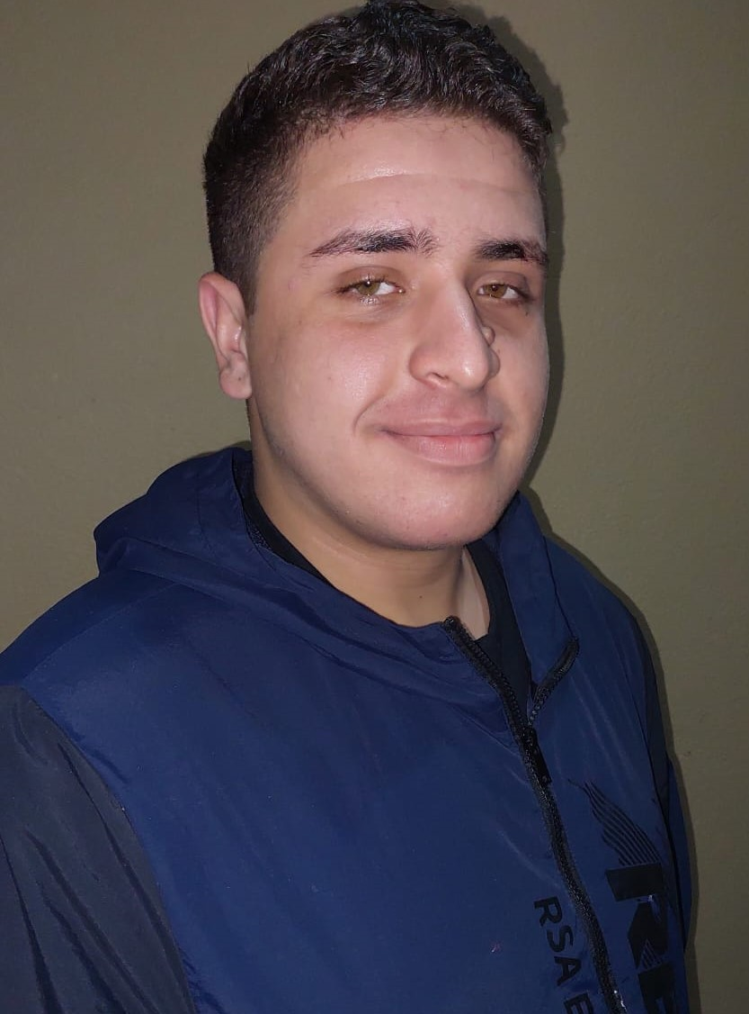
Team Members
Pasqaulo Shields
Maxime Declerck
Malcom J. Thonger
Team Lead
Lead Artist
Developer
Supporting Designer
UI Designer
Supporting Sound Designer
Sybrandt v. Niekerk
Eugene v.d. Berg
Nasser el Quoar
Sound Designer
Support Developer
Developer
Level Designer
Supporting Artist

Slide 5

CV.io
Theme: Employment
Genre: Role-Playing
Figure 1: Employment Picture (Geeksforgeeks, 2023)

Slide 6
Overview
In CV.io, step into the shoes of a hiring manager where every CV you approve or reject shapes the office’s success and morale. Hire wisely, fire strategically, and build the ideal team—or face the consequences!
Notes:
shoes of a hiring manager, approve or reject shapes success and morale. Hire wisely, fire strategically

Slide 7
02
Game Concept

Slide 8
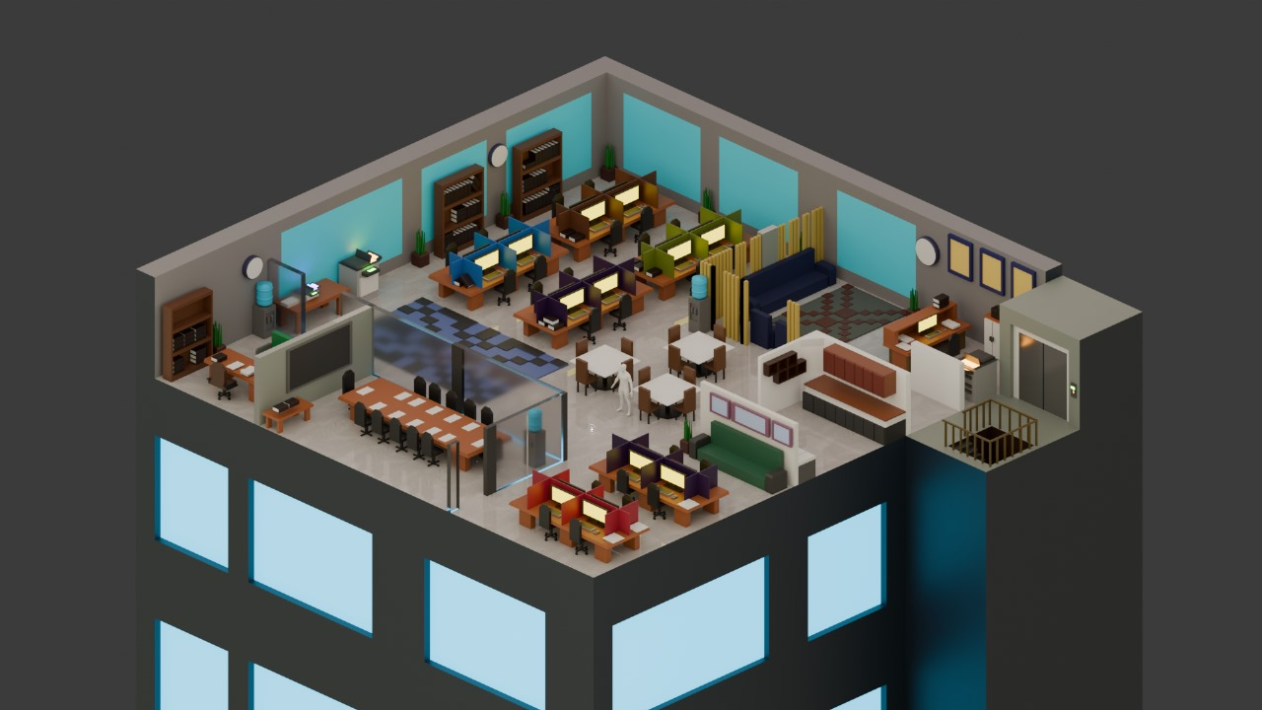
World:
Set in office building
Expanding game studio
Studio needs employees to grow
Figure 2: New Office Floor (el Quoar, 2024)

Slide 9
Story:
Player is put in the role of a Hiring manager
Player has 5 days
Every day, new potential employees will apply
Game will get harder as days pass

Slide 10
Gameplay Overview:
Analyse CV
Manage Employees
CV Generation
Day Cycles
Critically analyse CVs & compare them
Manage a list of hired employees
Move to a better role
New CV generated each day
More added as days progress
Day Consists of certain amount of hours
Play game within these hours

Slide 11
-Unique Selling Point
Educational Game
Enlightened perspective from both sides of hiring process
Connect in game concepts to real world

Slide 12
03
Target Audience

Slide 13
Primary Target Audience
Young adults between ages of 18 – 35 who are currently looking for work

Slide 14
Player Types:
Achiever Player Type
Motivated by a sense of progression which they will perceive while learning more about CVs as the game progresses

Slide 15
Appropriateness
South African youths that do not study further are more at risk of Job unemployment.
Lack of education on how to make themselves more appealing in a competitive market is the primary issue.
Teaches them how to make a CV in a simple way
Teaches them why a CV is important and what is expected.
Gives them a chance to learn if they never had the opportunity.

Slide 16
04
Visuals & Art Style

Slide 17
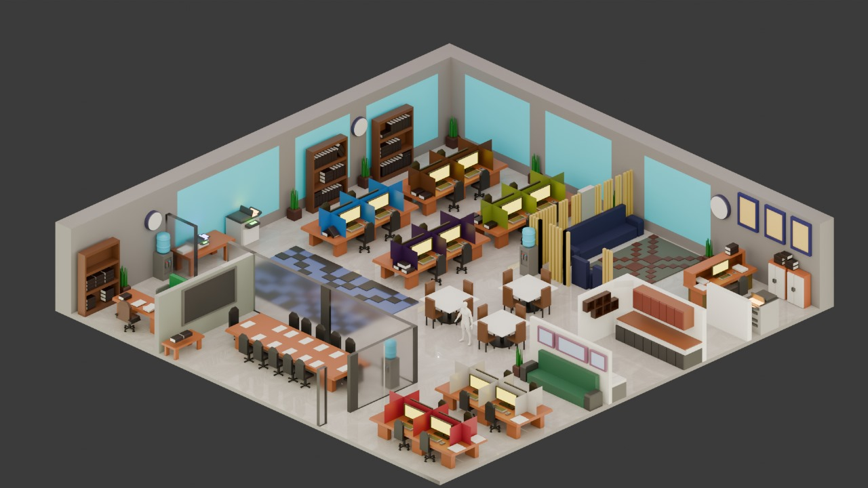
Game World
Figure 3: Initial Office Environment (el Quoar, 2024)
Basic, Single-Office level
Figure 4: New Office Floor (el Quoar, 2024)

Slide 18

Game World
Office with the rest of environment
Figure 5: New office floor with Highrise (el Quoar, 2024)

Slide 19
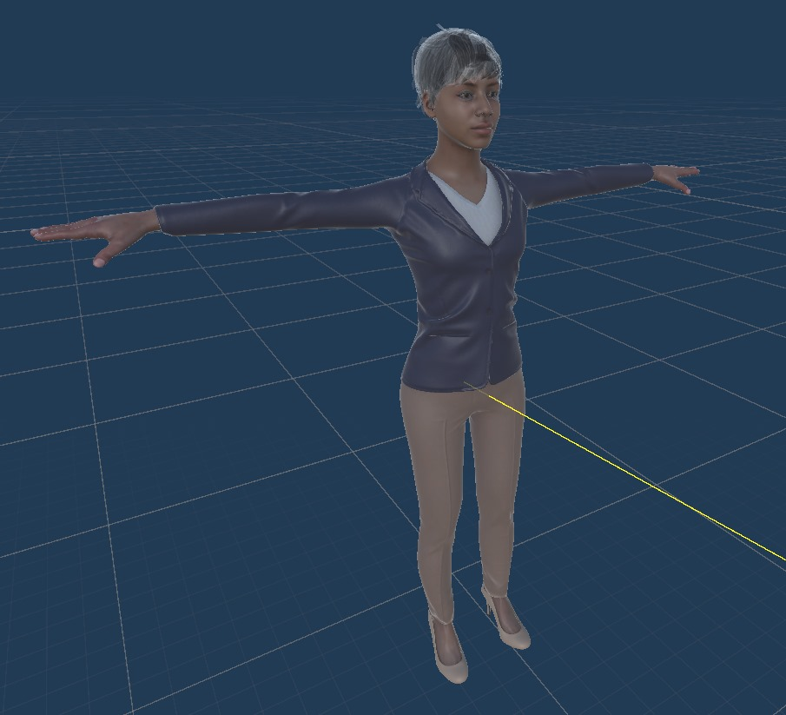
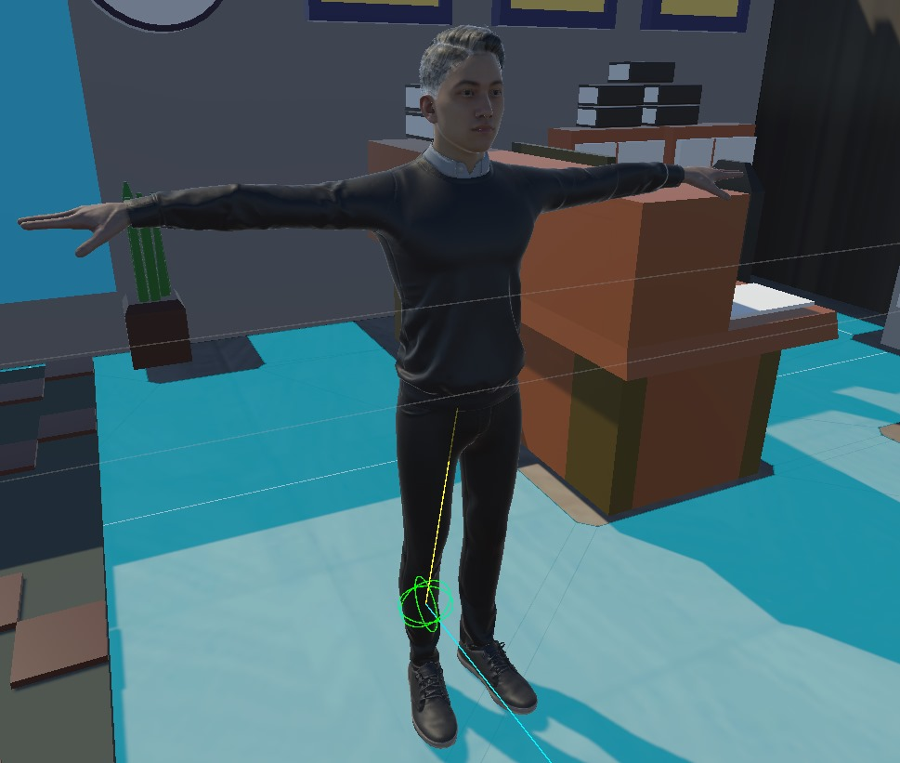
Employees
Employee Model 1
Employee Model 2
Employee model in Inspector
Employee Model placed in the Environment
Figure 6: Character Model (Mixamo, 2024)
Figure 7: Character Model 2 (Mixamo, 2024)

Slide 20
User Interface
Make your Own CV UI
Figure 8: CV Design (Thonger, 2024)
Notes:
Mention style consistency, learnability and useability of the design, and the old school influence of the computer style Windows 7 style UI

Slide 21


User Interface
Main Menu Screen
Figure 9: Main Menu Design (Shields, 2024)
Notes:
Mention style consistency, learnability and useability of the design, and the old school influence of the computer style Windows 7 style UI

Slide 22
05
Development Roadmap

Slide 23
Current Progress
Art Assets
Development
Employee Management Menu
UI Assets for Main Game Display
Employee Management
Game Manager

Slide 24
Progress
Where we are Currently
Planning
Prototype
Launch
Designing an idea to teach people an important skill
Creating a minimum viable product
Fully functioning and Enjoyable game

Slide 25
Project Plan
Figure 9: Project Plan (v.d Berg, 2024)

Slide 26
06
Call to Action

Slide 27
What We Are Asking For
Funding/support
Advertising
Publishing
Time/Patience
We need funding in order to finish the game and publish on major platforms
After funding and the games release, we will start an advertising campaign
We would like to publish the game under Steam, Epic Games, and Itch.io for maximum audience reach
With funding there will still be a window of development before release

Slide 28
Why Invest?

Slide 29
8.4 Million
South africans are unemployed currently as of Q2 of 2024

Slide 30
Opportunity
CV.io is a unique opportunity to you as there is no other game on market that caters this mixture of fun engaging gameplay and learning opportunities for CV’s and job hunting.
There’s a large opportunity to have a good return on investment. If you invest, we’ll be able to publish our game and begin marketing it, allowing for people to find and engage with it.

Slide 31
Return on Investment (ROI)
Low price:
Attract high customer rates
Catering towards the unemployed
Better strategy than selling fewer copies at higher cost.
At R25 a copy of the game assuming just 15% of the unemployed South Africans buy the game, yields roughly R1.2 million.
And assuming roughly 2-5% of the employed population also plays the game that’s an additional 168-420K .
Notes:
Speak to the investors financial interest, ensure that investing seems like a great choice.
The 15% stat comes from the stat that 30% of south africans have PC’s and so assuming (and possibly incorrectly) that 30% of the unemployed have PC’s, means we just grab half of that and assume they’ll play the game.
2-5% is not a researched statistic but is rather a ball park figure of what percentage of non-eligible players we can expect as outliers in the playerbase.

Slide 32
—Edouard Mendy
When you are unemployed, you tell yourself that you are not going to find a way out.
That’s why we need to create this game.
To help those people find their way out…

Slide 33
Thank You

Slide 34
Acknoledgements
Pasqaulo Shields
Maxime Declerck
Sybrandt van Niekerk
Nasser el Quoar
Eugene van den berg
Malcom Joe Thonger

Slide 35
References
Geeksforgeeks. Employment Picture. [Online]. Available at: https://www.geeksforgeeks.org/employment-meaning-importance-basic-terms-of-employment-and-participation-of-people-in-employment/ [Accessed 28 October 2024]
El Qouar, N. 2024. New Office Floor. [Personal Screenshot]. Pretoria: Unpublished.
El Qouar, N. 2024. Initial Office Environment. [Personal Screenshot]. Pretoria: Unpublished.
El Qouar, N. 2024. New office floor with Highrise. [Personal Screenshot]. Pretoria: Unpublished.

Slide 36
References
Mixamo. (2024). Brian [Asset pack]. Adobe Systems Incorporated. Available at: https://www.mixamo.com/#/?page=1&type=Character [ Accessed 14 November 2024]
Mixamo. (2024). Brian [Asset pack]. Adobe Systems Incorporated. Available at: https://www.mixamo.com/#/?page=1&type=Character [ Accessed 13 November 2024]
Mixamo. (2024). Elizabeth [Asset pack]. Adobe Systems Incorporated. Available at: https://www.mixamo.com/#/?page=1&type=Character [ Accessed 14 November 2024]
Mixamo. (2024). Joe [Asset pack]. Adobe Systems Incorporated. Available at: https://www.mixamo.com/#/?page=1&type=Character [ Accessed 11 November 2024]
Mixamo. (2024). Josh [Asset pack]. Adobe Systems Incorporated. Available at: https://www.mixamo.com/#/?page=1&type=Character [ Accessed 13 November 2024]
Mixamo. (2024). Leonard [Asset pack]. Adobe Systems Incorporated. Available at: https://www.mixamo.com/#/?page=1&type=Character [ Accessed 14 November 2024]

Slide 37
References
Mixamo. (2024). Louise [Asset pack]. Adobe Systems Incorporated. Available at: https://www.mixamo.com/#/?page=1&type=Character [ Accessed 11 November 2024]
Mixamo. (2024). Martha [Asset pack]. Adobe Systems Incorporated. Available at: https://www.mixamo.com/#/?page=1&type=Character [ Accessed 13 November 2024]
Mixamo. (2024). Megan [Asset pack]. Adobe Systems Incorporated. Available at: https://www.mixamo.com/#/?page=1&type=Character [ Accessed 12 November 2024]
Mixamo. (2024). Rem [Asset pack]. Adobe Systems Incorporated. Available at: https://www.mixamo.com/#/?page=1&type=Character [ Accessed 12 November 2024]
Mixamo. (2024). Suzie [Asset pack]. Adobe Systems Incorporated. Available at: https://www.mixamo.com/#/?page=1&type=Character [ Accessed 12 November 2024]

Slide 38
References
Thonger, M. 2024. CV Review UI. [Personal Screenshot]. Pretoria: Unpublished.
Shields, P. 2024. Main Menu UI. [Personal Screenshot]. Pretoria: Unpublished.
v.D Berg, E. 2024. Project Plan. [Personal Diagram]. Pretoria: Unpublished.
Mendy, E. n.d. When you are unemployed, you tell yourself that you are not going to find a way out. [Online]. Available at: https://www.brainyquote.com/quotes/edouard_mendy_1225213 [Accessed 10 November 2024].
news24. 2024. Unemployment rate jumps to 33.5%, 8.4 million South Africans now jobless. [Online]. Available at: https://www.news24.com/fin24/economy/unemployment-rate-jumps-to-335-84-million-south-africans-now-jobless-20240813
[Accessed 10 November 2024].

